Slide 1
The Grand Lake Brewing Company
Highest Packaging Microbrewery in the World
Karen Wood, Co-Owner
MBAA-RMD
Out-of-Towner Meeting
Grand Lake, Colorado
September 25, 2010

Slide 2

“If It Was Easy To Make, It Would Be Wine”
Eric Kohl

Slide 3
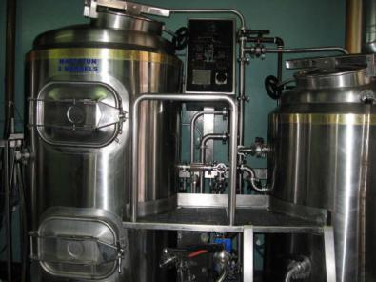
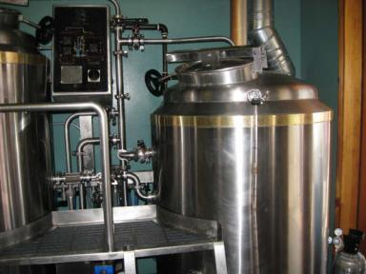
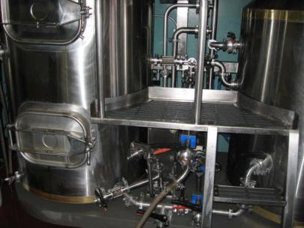
Our First Brewhouse
2002

Slide 4
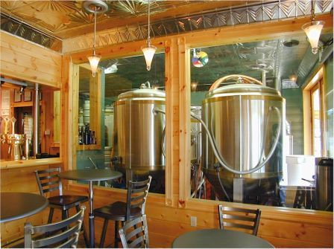
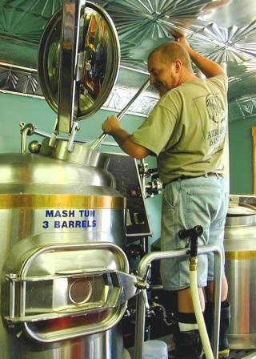
First Brewhouse Location

Slide 5
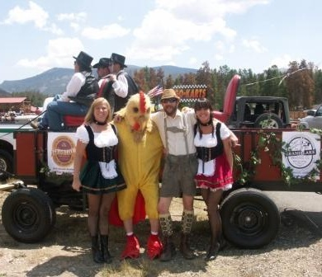
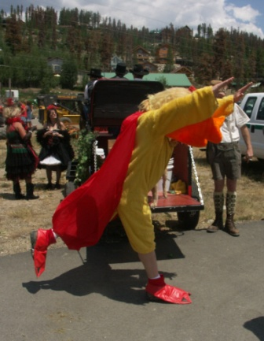
Grand Lake Parade

Slide 6
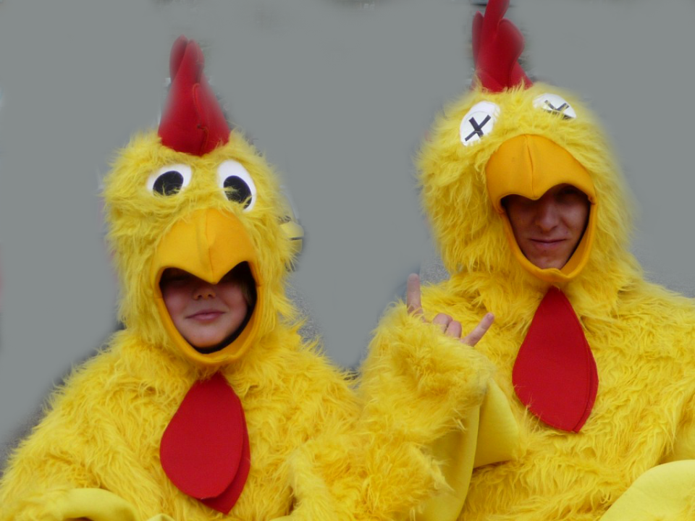
Super Chickens

Slide 7
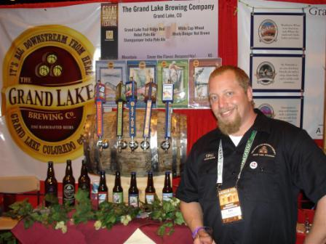
Eric Kohl, Head Brewer

Slide 8
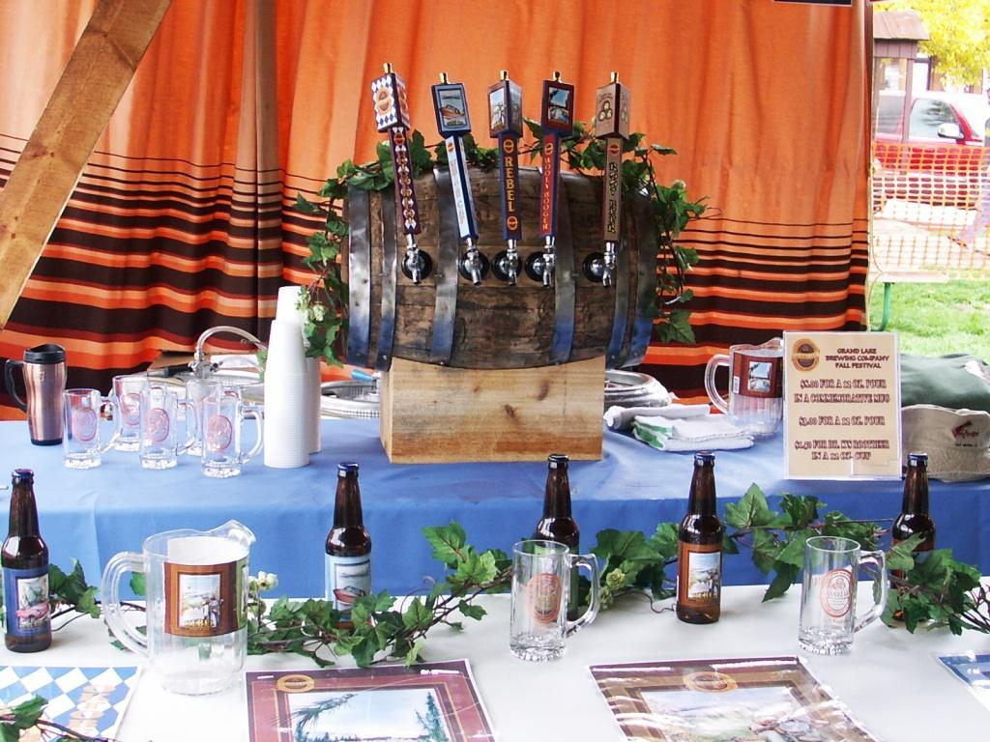

Slide 9
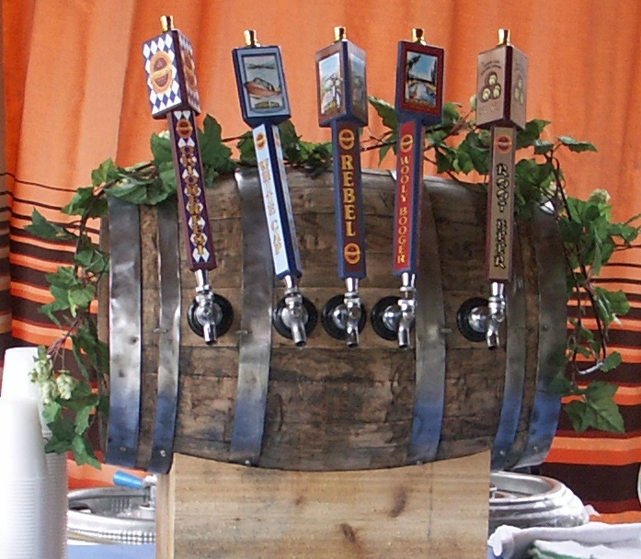

Slide 10
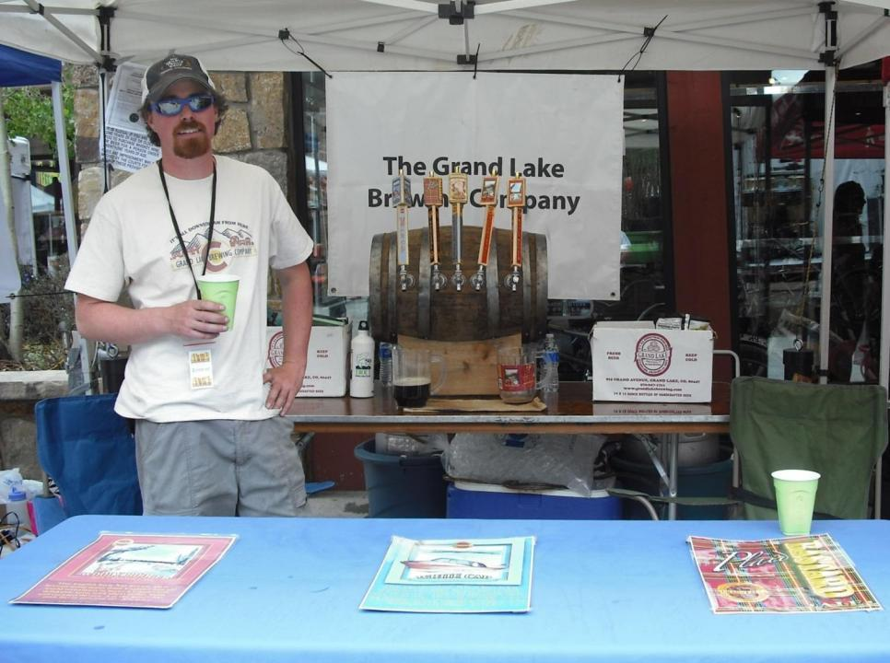
Tom (Brewer) at Beer Festival

Slide 11
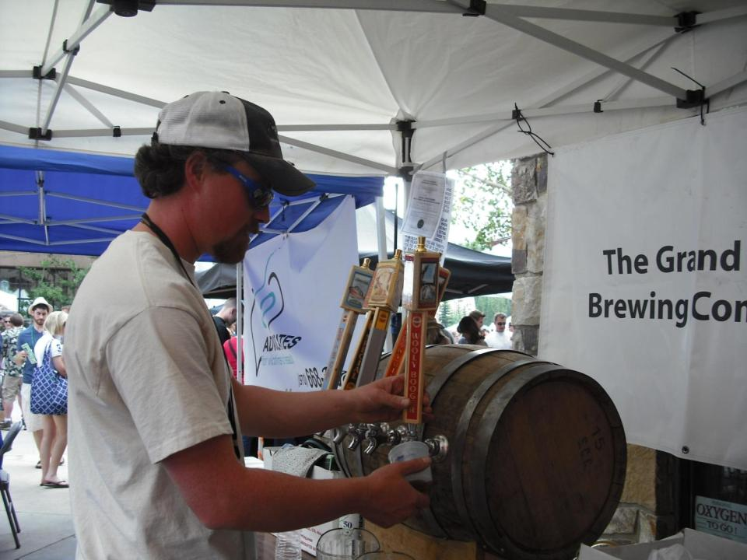

Slide 12
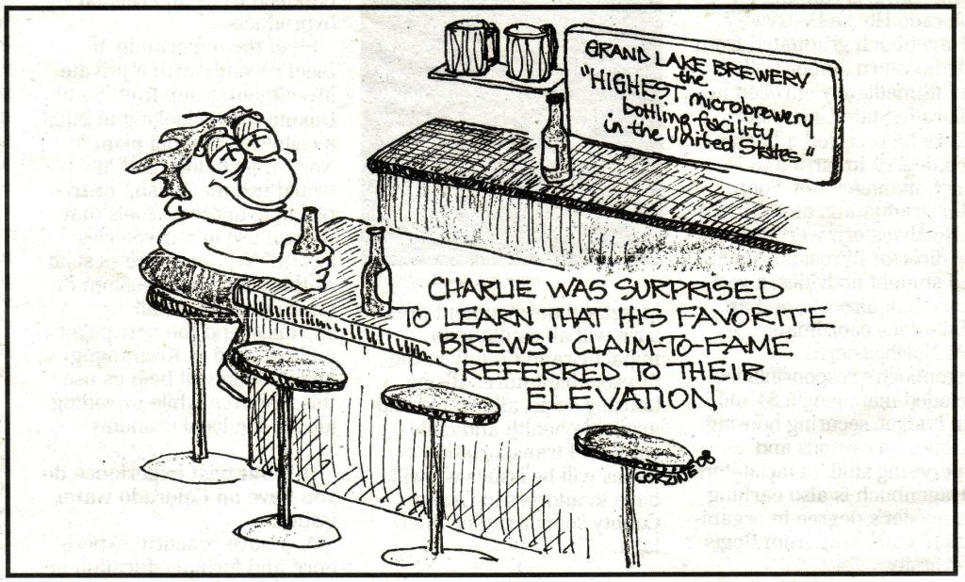

Slide 13
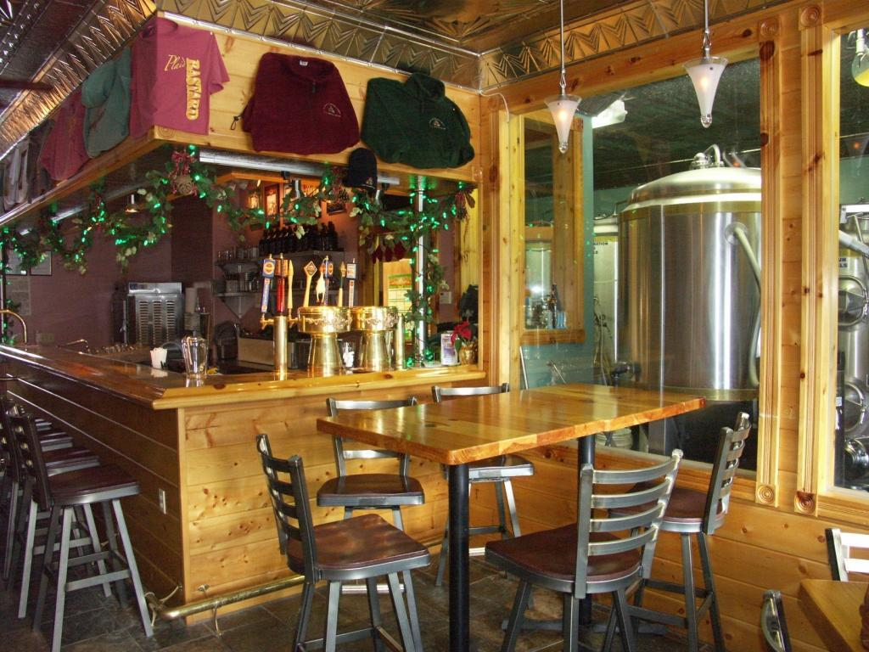

Slide 14
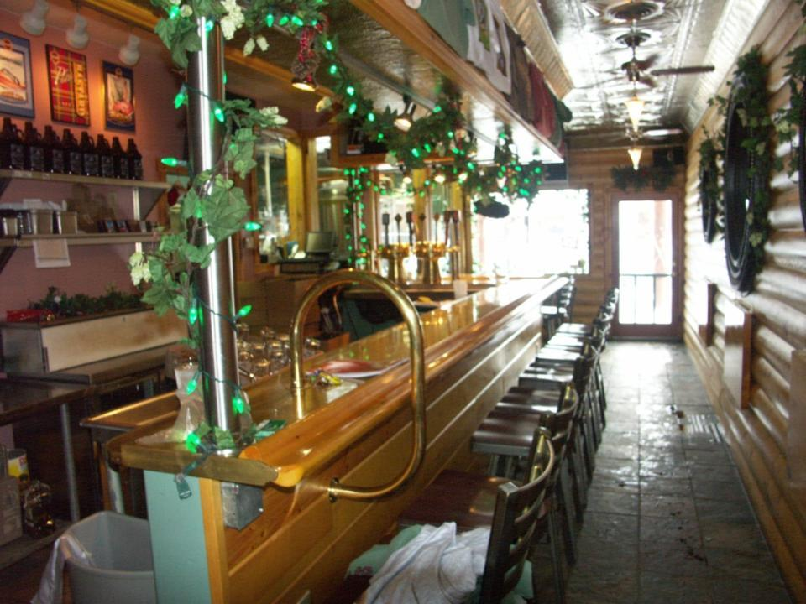

Slide 15
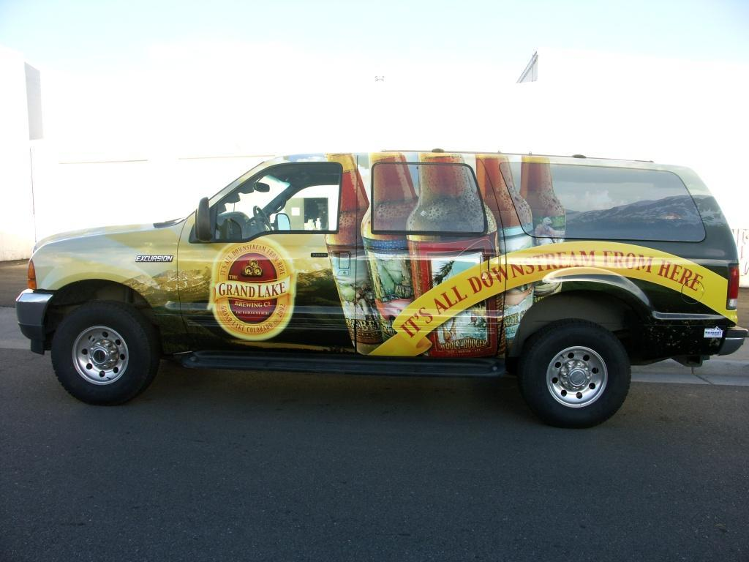

Slide 16
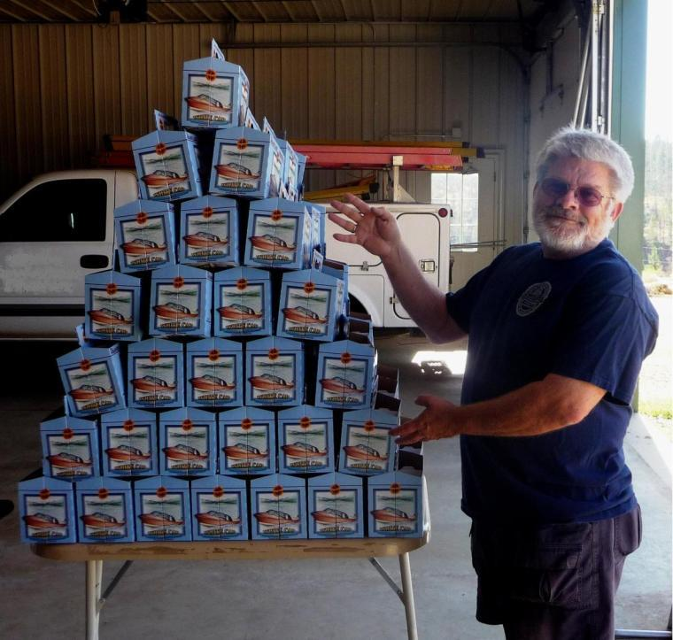
Richard A. Wood (co-owner)

Slide 17
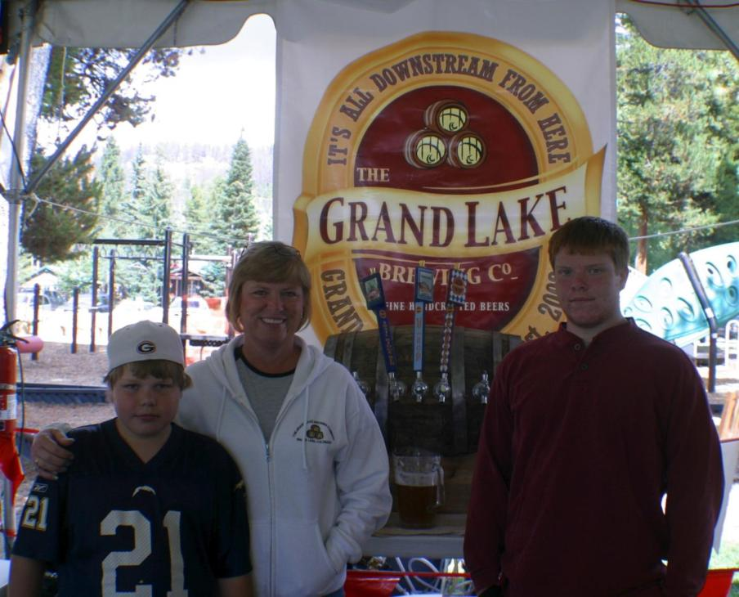
Hunter, Karen (co-owner) and Warren

Slide 18
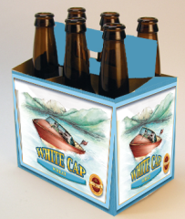
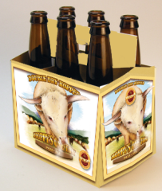
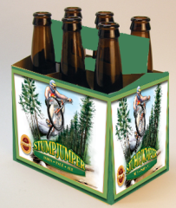
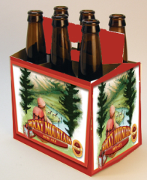
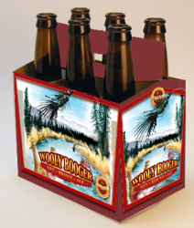
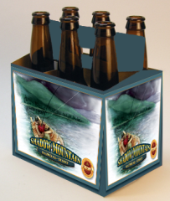
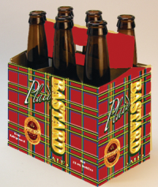
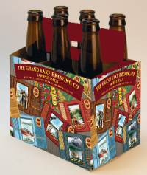
Our Handcrafted Beers

Slide 19
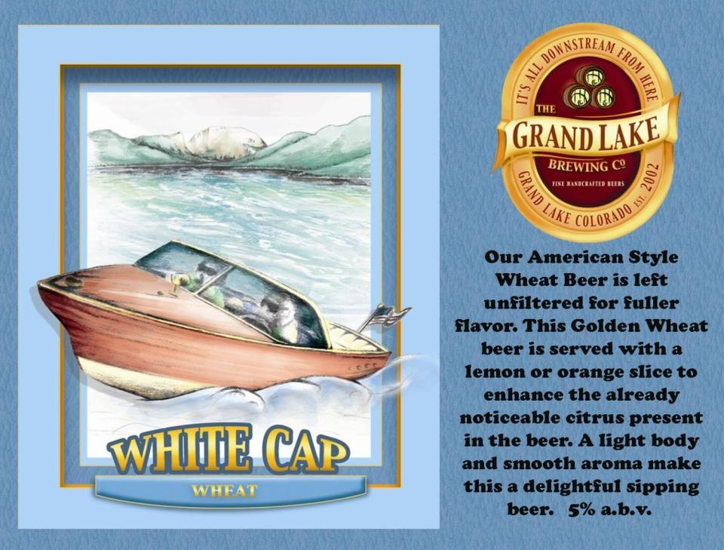

Slide 20
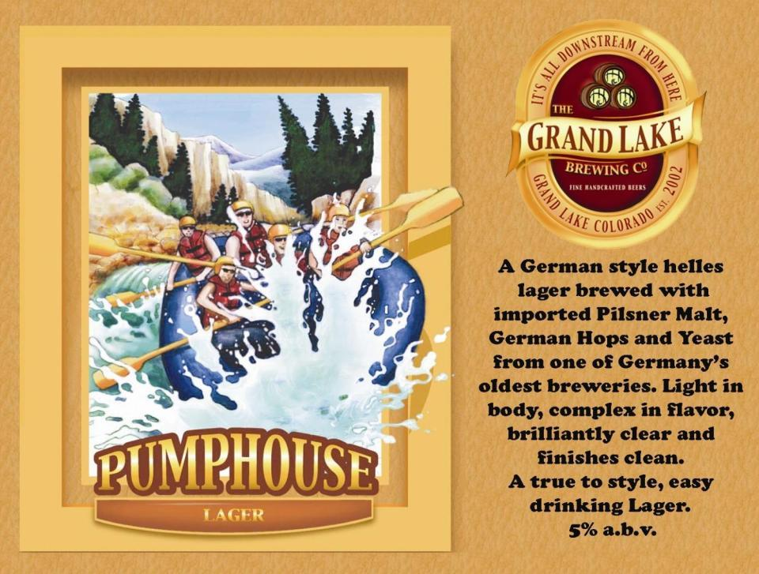

Slide 21
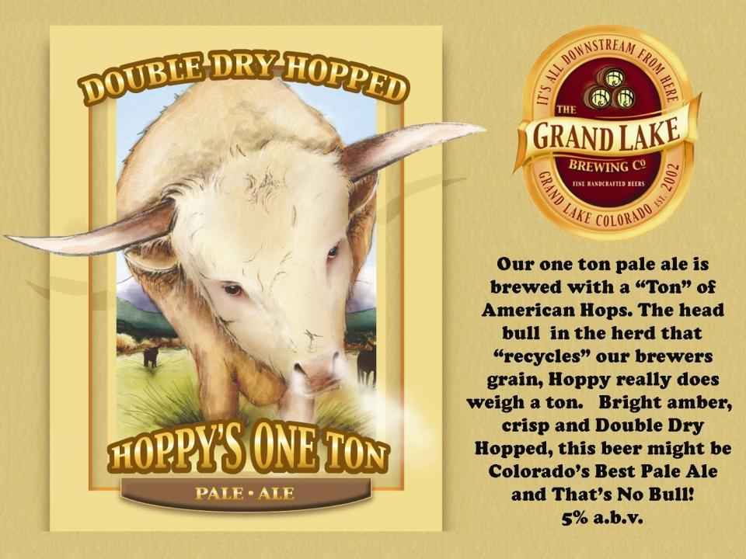

Slide 22
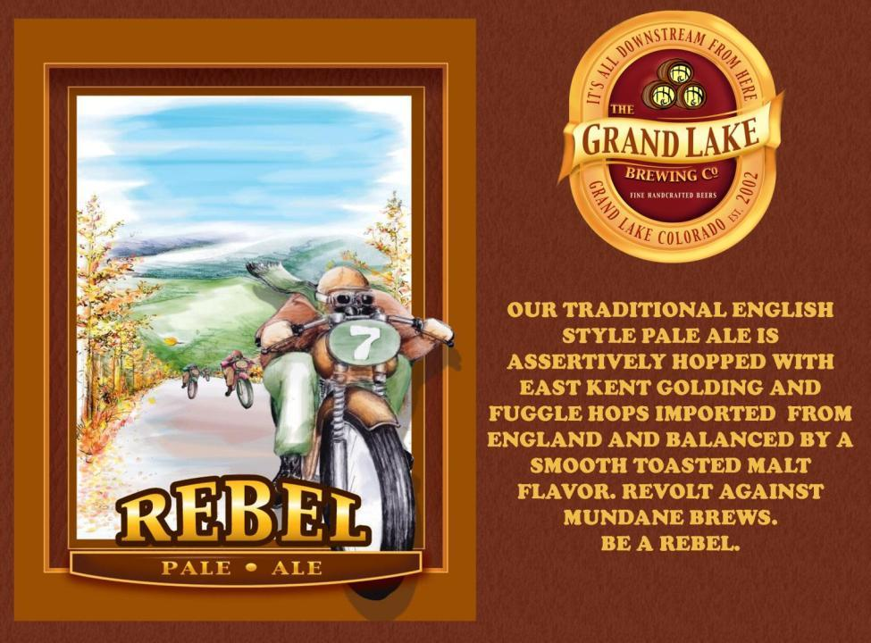

Slide 23
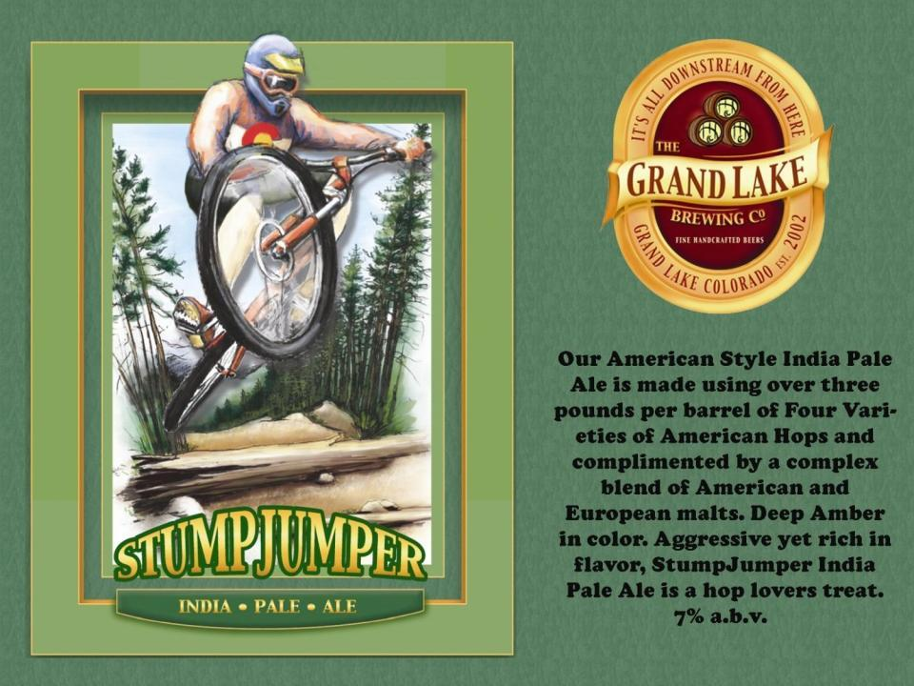

Slide 24
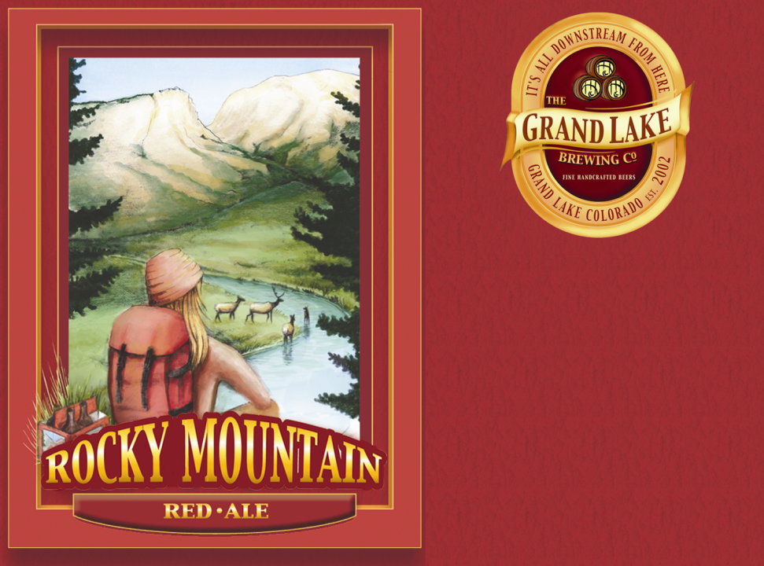
Our American Style Red Ale is deep amber in color and complex in flavor. A well balanced beer with medium body and a smooth finish. This beer is a blend of American and British Malts accented with a healthy dose of American Hops.
5% a.b.v.

Slide 25
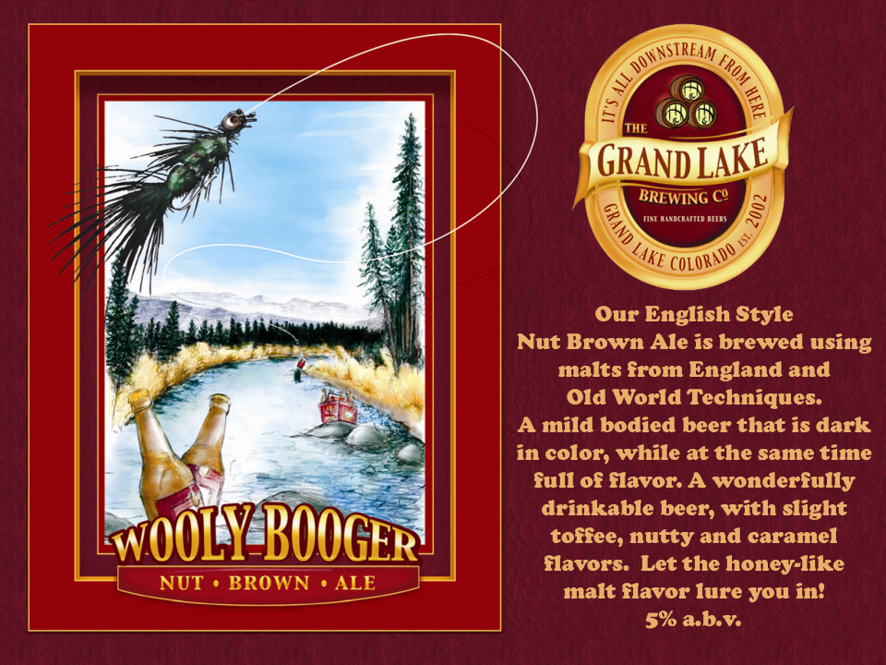

Slide 26
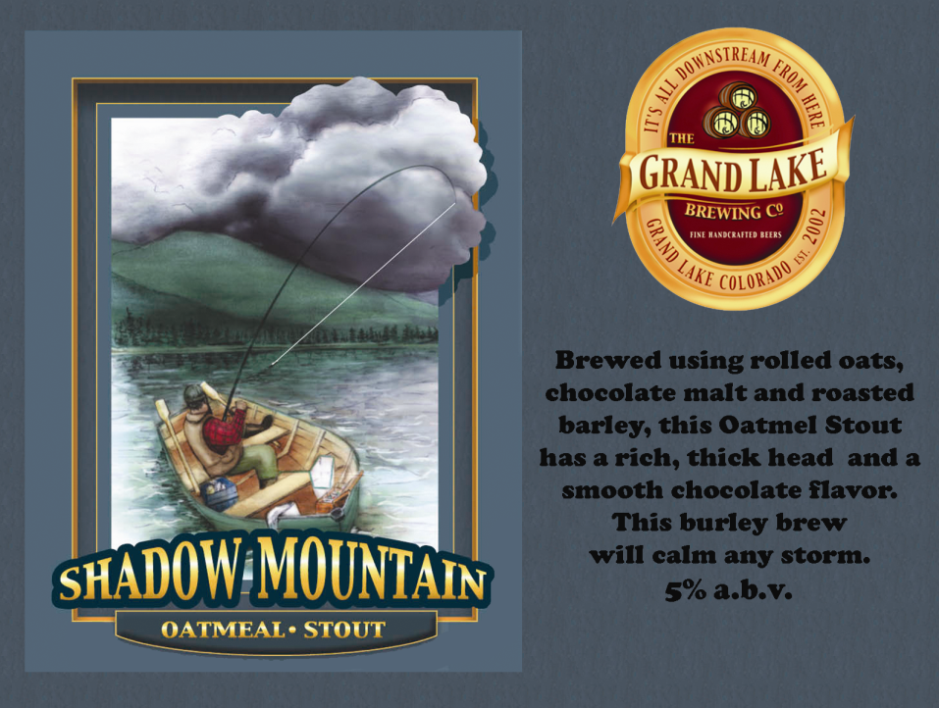

Slide 27
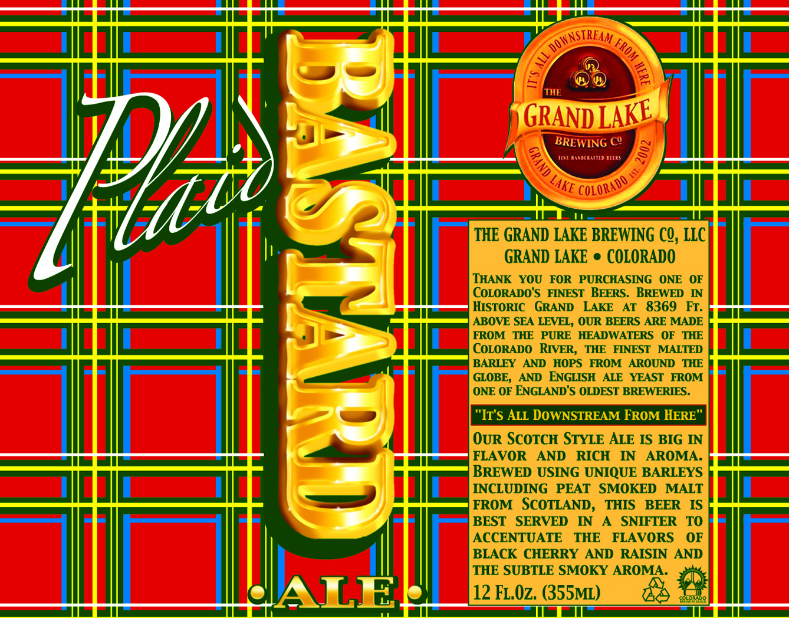

Slide 28
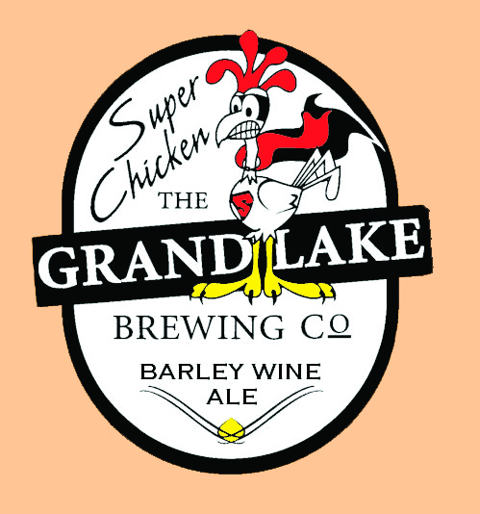
An American Barley Wine that is amazing in flavor and body. Intense and smooth with hints of raisin in the finish. As huge as the mountain it is named after.
11% a.b.v.

Slide 29
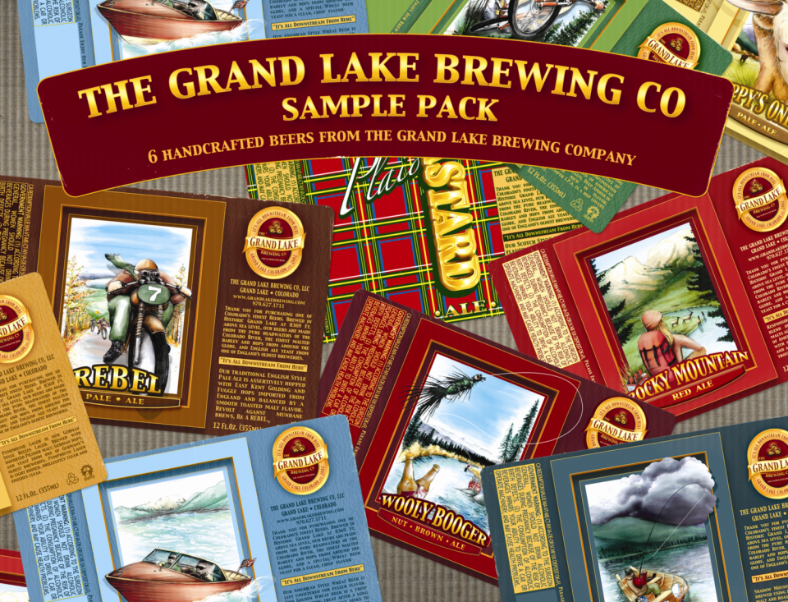

Slide 30
Brands available in Six Packs are:
White Cap Wheat
Wooly Booger Nut Brown Ale
Plaid Bastard Scotch Ale
Shadow Mountain Stout
Stumpjumper IPA
Hoppy’s One Ton Pale Ale
Sampler Six Pack with Six Different Brands
Brands available only in Sampler Six Packs or at the Brewpub:
Rebel Pale Ale
Pumphouse Lager
Super Chicken Barley Wine available in 12 ounce bottles sold individually.

